Slide 1

Solar-Swap

Slide 2
Table of contents
Our Team
Our Idea
Tech Stack

Slide 3
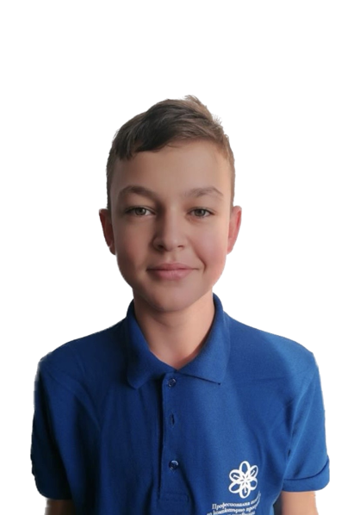
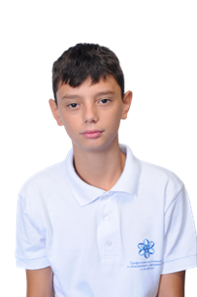
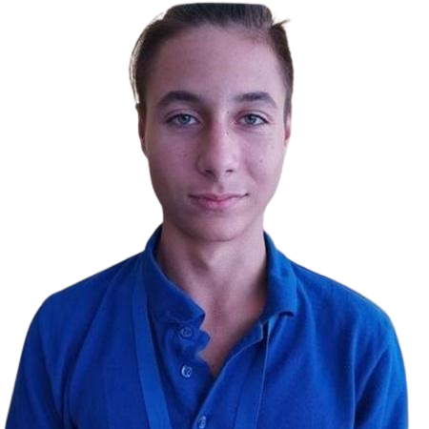
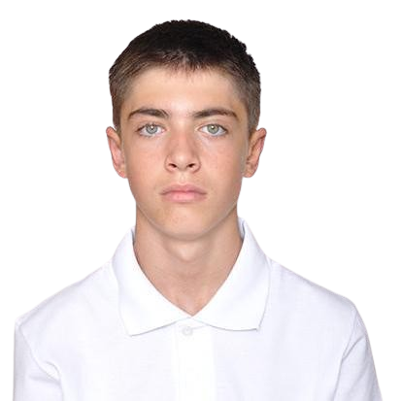
Our Team
Scrum trainer
Asparuh Georgiev
Front-end developer
Veselin Naydenov
Front-end developer
Georgi Stoyanov
Front-end developer
Georgi Georgiev

Slide 4
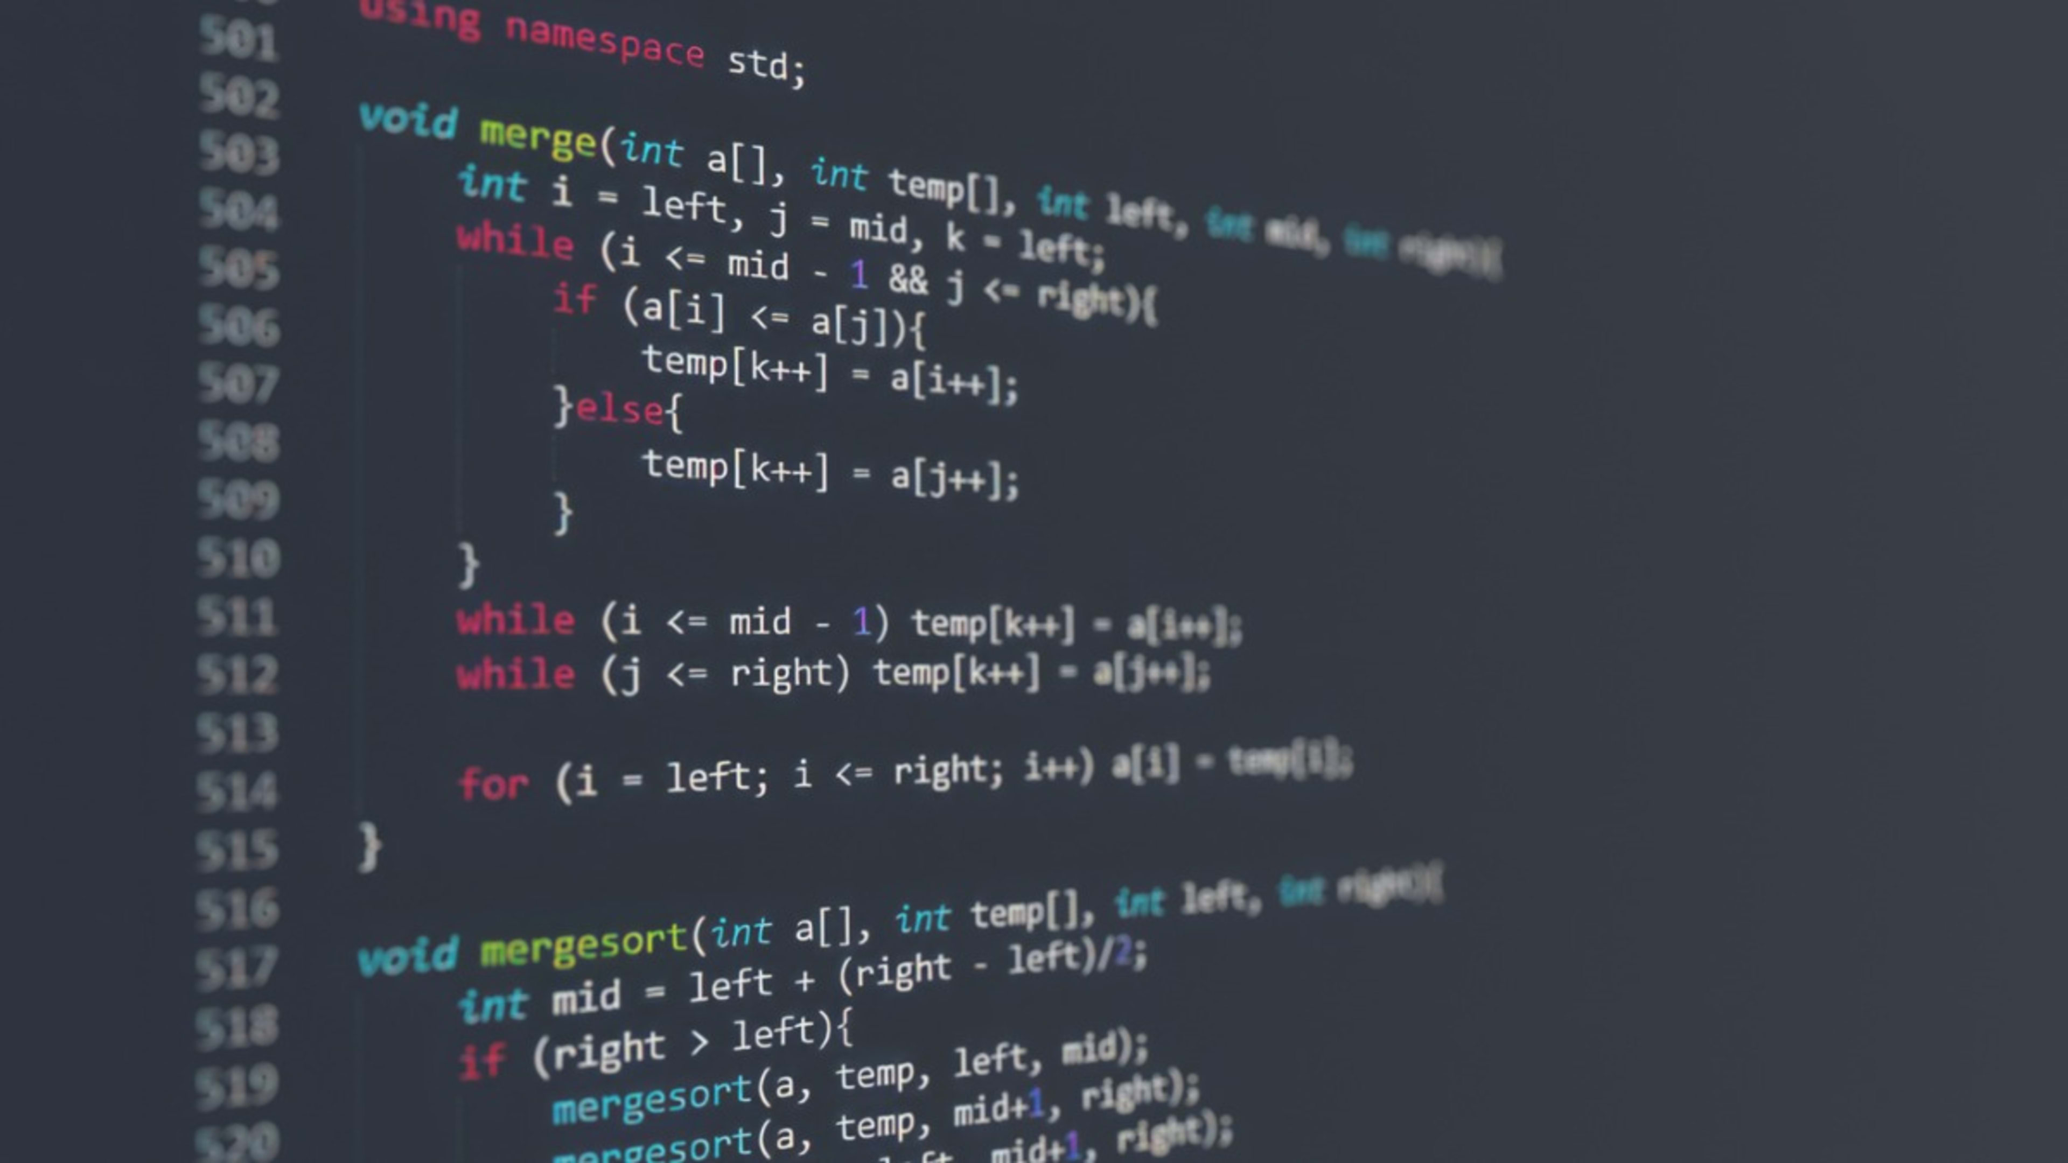
Our Idea
Our idea was to create a game that is related to physics.

Slide 5





Tech Stack

Slide 6
Lets move on with our project.

